Slide 1
IMPACT EVALUATION RETOOLING WORKSHOP
By
Blessing Ose Oligbi PhD
Economics Department
Igbinedion University Okada
NAIROBI, KENYA JULY 1- 7, 2024

Slide 2
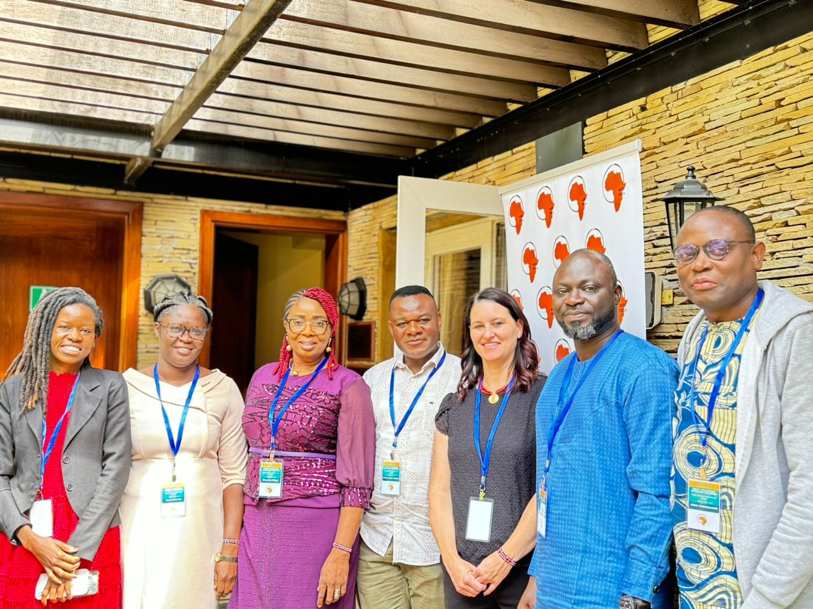

Slide 3
BACKGROUND
Organized by African Economic Research Consortium
In conjunction with
University of North Carolina, United States of America
&
The American Institutes for Research (AIR)

Slide 4
ATTENDANCE
A gathering of scholars from Sub-Saharan Africa
30 participants from more than 10 African countries
Participating Countries: Benin Republic, Kenya, South Africa, Ghana, Liberia, Zimbabwe, Namibia, Nigeria, Gambia, Cameroon, Uganda, Zambia, etc)

Slide 5
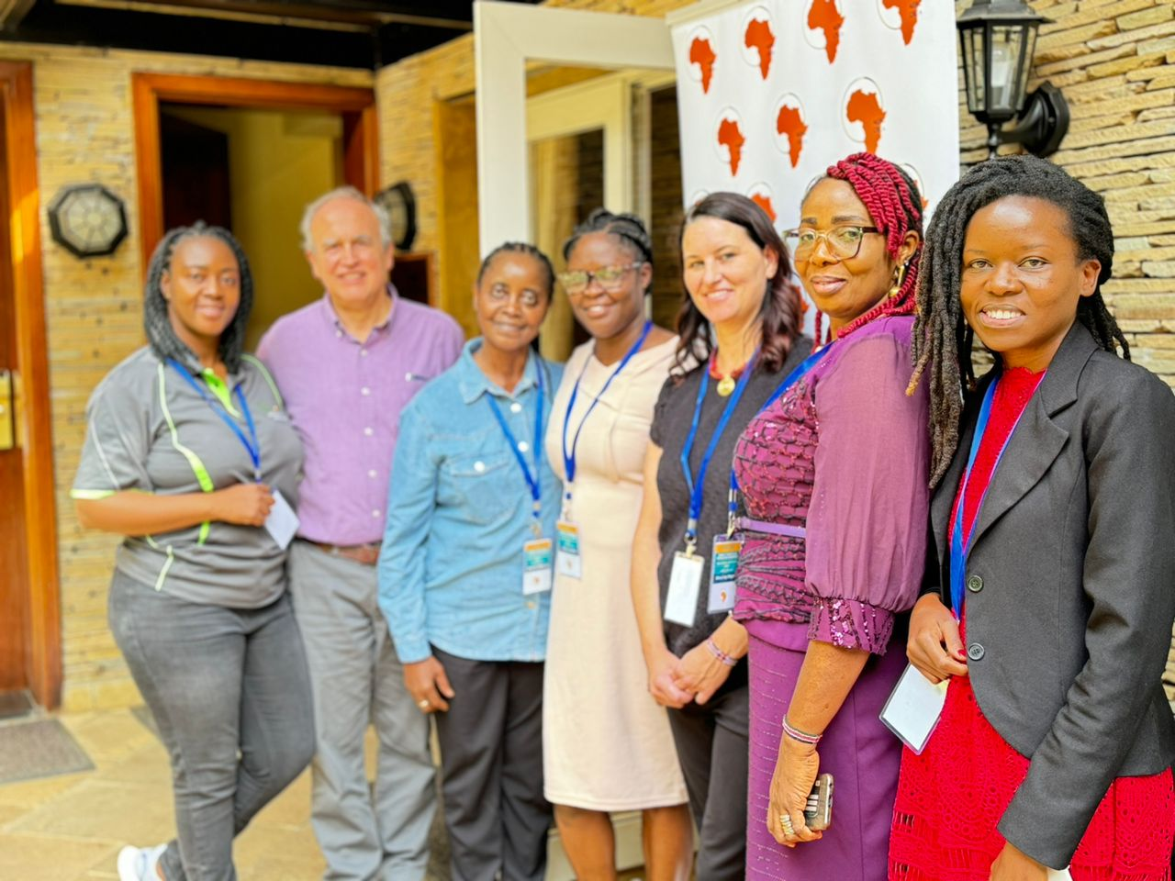

Slide 6
THE WORKSHOP
For scholars to extend the frontiers of scholarship in Africa through training on the use of cutting-edge research tools
To re-evaluate the major approaches to research in Economics and the appropriate use of data analysis tools for reliable results
Practical application of STATA tools for data analysis of household data

Slide 7
The workshop was meant to empower scholars to do a better evaluation of intervention programmes across the continent
Intensive training in the concepts of programme evaluation and in the designs and techniques for evaluating programme impact.
The workshop consists of lectures, Stata practical sessions, case studies, and group work.

Slide 8
PARTICIPATION
I participated as one of the two scholars representing Nigeria, the other participant being from the University of Ibadan.
I participated as a Faculty member of the African Economic Research Consortium

Slide 9
CONCLUSION
The workshop was a useful outlet for academic linkages and to showcase the IUO brand within the academic community
It provided the opportunity to interact with other scholars and share ideas

Slide 10
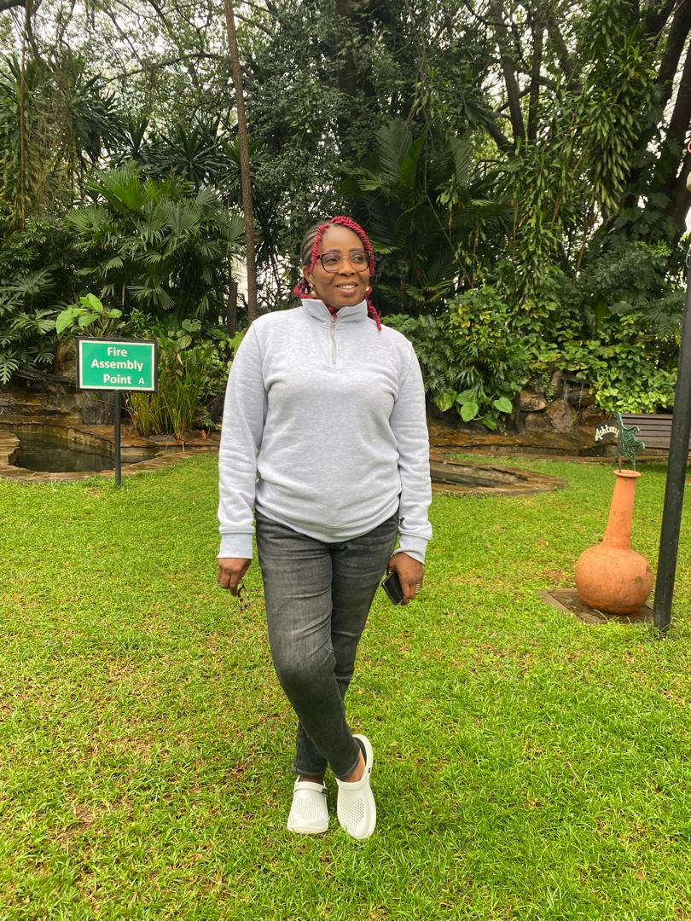

Slide 11
APPRECIATION
Many thanks to the Vice Chancellor for the usual encouragement and the nurturing of a community of scholars ready to dominate the world

