Slide 1
HIGHLIGHTS OF THE STUDY CONDUCTED ON ENHANCING ACCESS TO DIGITAL FINANCIAL PAYMENT SERVICES FOR WOMEN AND MINORITY GROUPS IN URBAM-RURAL AREAS IN NIGERIA

Slide 2
THIS WORK WAS DONE IN COLLABORATION WITH:
LIVERPOOL JOHN MOORES UNIVERSITY
AND
IGBINEDION UNIVERSITY OKADA

Slide 3
PRINCIPAL INVESTIGATOR:
PROF. LAWRENCE IKECHUKWU EZEMONYE, PhD, FAS
(Professor of Ecotoxicology and Environmental forensic)
RESEARCH ASSISTANT:
PATIENCE LILIAN OZOR, PhD

Slide 4
AIM OF THE STUDY
FINDING METHODS TO INCREASE ACCESS TO DIGITAL FINANCIAL PAYMENT SERVICES FOR WOMEN AND MINORITY GROUPS IN URBAN-RURAL AREAS OF NIGERIA WITH SPECIAL EMPHASIS ON WOMEN IN THE PRIVATE SECTOR IN THE SOUTH-SOUTH REGION.

Slide 5
OBJECTIVES
THE OBJECTIVES OF THIS STUDY IS TO:
INVESTIGATE HOW AGENCY BANKING CAN INCREASE FINANCIAL INCLUSION IN URBAN-RURAL AREAS OF NIGERIA.
IMPROVE TRUST BETWEEN FINANCIAL SERVICE PROVIDERS AND ETHNIC WOMEN IN THESE AREAS.
ENHANCE FINANCIAL LITERACY IN URBAN-RURAL AREAS OF NIGERIA

Slide 6
METHODOLOGY
THE QUESTIONNAIRE WAS THE INSTRUMENT EMPLOYED FOR THE COLLECTION OF DATA IN THIS RESEARCH.
LOCATION: THE SIX STATES OF THE SOUTH-SOUTH REGION OF NIGERIA
SAMPLE SIZE: 600 (100 PER STATE)

Slide 7
RESULTS
Figure 1:Age Group of Respondents

Slide 8
Figure 6: Adoption and Utilization of Mobile Banking Services

Slide 9
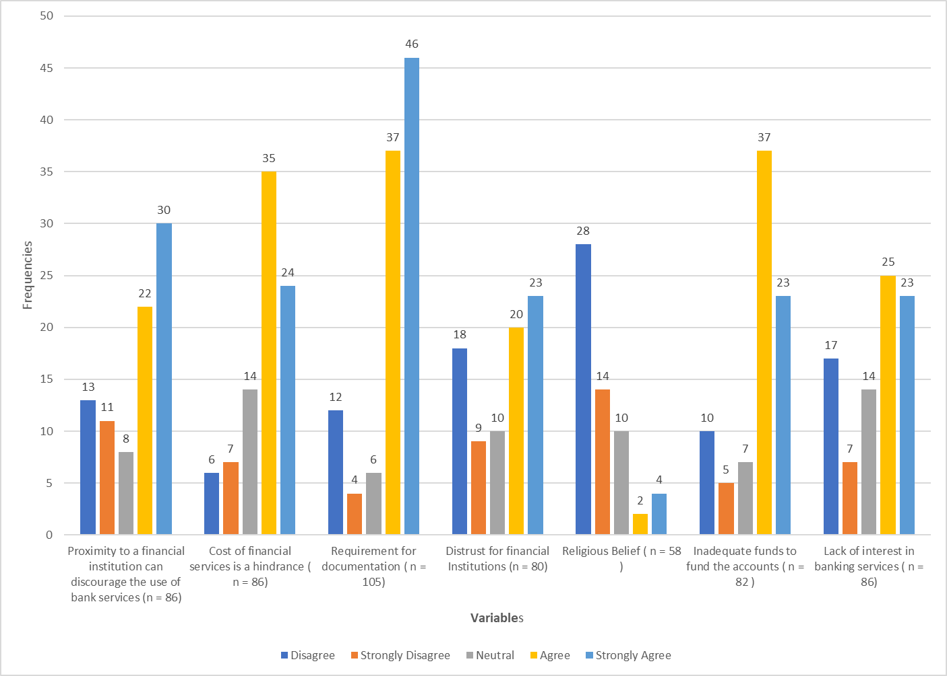
Figure 7: Factors Responsible for not operating a Bank Account

Slide 10
KEY RESULTS

Slide 11
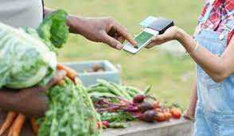
Despite widespread use of mobile phones by the participants, only 54.6% of them use their mobile phones for banking services. This is due to
cost of financial services
non-flexible banking processes & documentation
poor Internet connectivity

Slide 12
RECOMMENDATIONS
Digital and financial literacy campaign for women and minority groups
A strong private and government support initiative needed to enhance access to better digital and financial literacy
Enhanced ease of doing banking transactions should be adopted
for better financial inclusion
Better and reliable internet connectivity

Slide 13
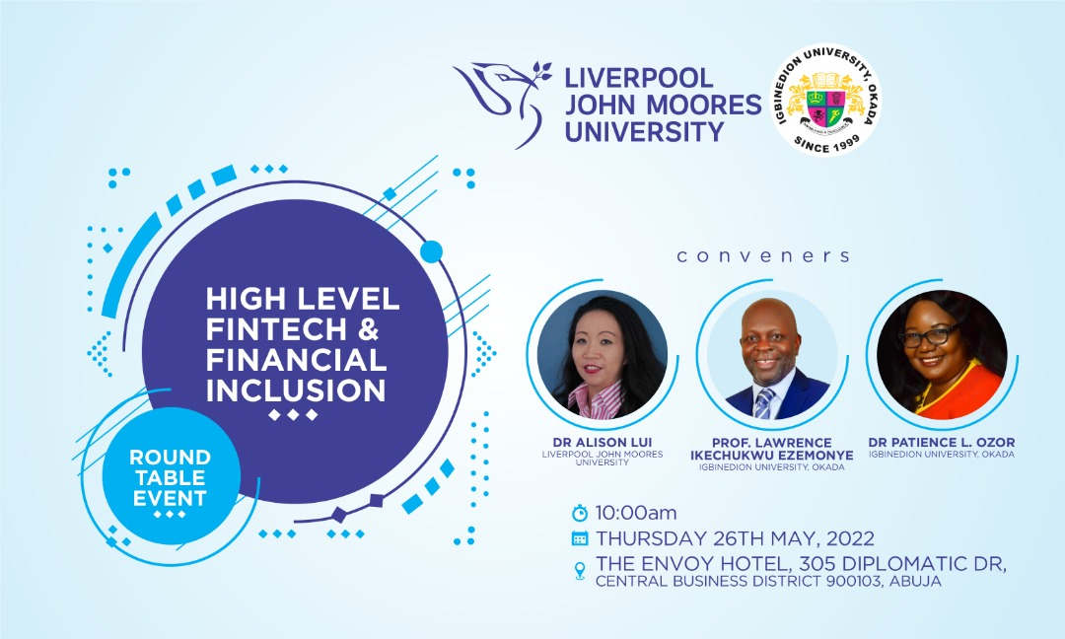
ABUJA ROUNDTABLE

Slide 16
RECOMMEDATIONS FROM THE ROUNDTABLE I
A. Partnership with the Ministry of Finance, Budget and National Planning for the sponsorship of a nationwide Financial Inclusion and Digital Literacy Campaign
B. Partnership with the Ministry of Women Affairs for a wider Financial and Digital literacy campaign, especially for women.
C. Proposed partnership with the Ministry of Youth and Sports (National Youth Service Commission) with a view to using corps members for a nationwide awareness campaign.
D. Proposed partnership with Digital Bridge Institute under the National Communication Commission for digital training support for the campaign.

Slide 17
AWEARNESS CAMPIAGN
Use of print and broadcast media
(Radio Jinle with Radio Nigeria and ITv)
Follow up documentary
Drama presentations

Slide 18
BENIN WORKSHOP I -TRAINING ON DIGITAL & FINANCIAL LITERACY

Slide 19
BENIN WORKSHOP I -TRAINING ON DIGITAL & FINANCIAL LITERACY

Slide 20
FACILITATORS
(1) “The Fundamentals of Financial and Digital Literacy”
by Mrs Evelyn Imode,
(2) “Planning and Managing Money: Investment, Saving, Risk and Reward”,
by Arabome Eboseremen Joy and
(3) “Security of Mobile Payment Platforms, Error Resolution and Consumer Protection”
by Ebehiwialu Adoghe Endurance.

Slide 23
BENIN WORKSHOP II - DISTRIBUTION PHONES

Slide 26
NORTH CENTRAL RESULT

Slide 29
Notes:
About 81% wants support for financial literacy

Slide 30
Notes:
About 86% wants support for digital literacy

Slide 31
CONCLUSION
Despite the increase in mobile phone ownership and usage the results is not much different from that of the south south region. There is still the gap in financial payment services.
Hence the need for more sensitization and training just like their counterparts in the south-south zone.

Slide 35
Actionable points
Training of NYSC members to carry out training for the women
Integrating digital and financial literacy into primary and secondary school curriculum.
Training the trainer through local association in their local dialects
Creating awareness through developing apps with mobile phone manufacturers

Slide 37
Notes:
WORKSHOP ON GOING

Slide 38
Notes:
THE VC, HON. MINISTER AND THE FACILITATORS

Slide 39
Notes:
THE VC, HON. MINISTER, THE FACILITATORS AND PARTICIPANTS

Slide 40
Facilitators
Planning and Managing Money
by Chukwuemeka Nzeih (digital bridge institute)
Money and Transaction
by Aisha Iya Abubakar (Xchange Box)
Mobile Payment Security, Error Resolution and Customer Protection
Jimoh Ridwan Abiola (C.E.O Xchange Box)

Slide 41
THANK YOU FOR LISTENING

